Slide 1
AY2021-22 AHEIS
MANUAL UPDATES
June 24, 2021

Slide 2
REPORTING CHANGES

Slide 3
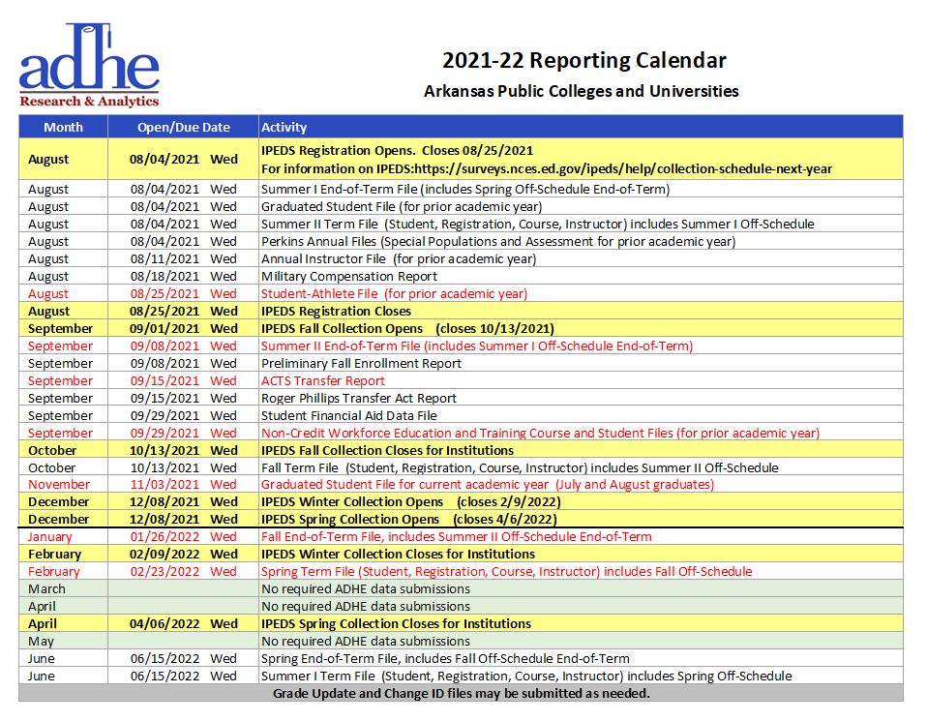
REPORTING DUE DATES
Notes:
Student Athlete, Summer II EOT, Fall EOT moved up ACTS Transfer moved back to original date Current year GSF and Spring DAT file moved later
Discussed with SISAC and hope the changes will help spread out the due dates to help with timely submissions
Trying to spread out to help institutions

Slide 4
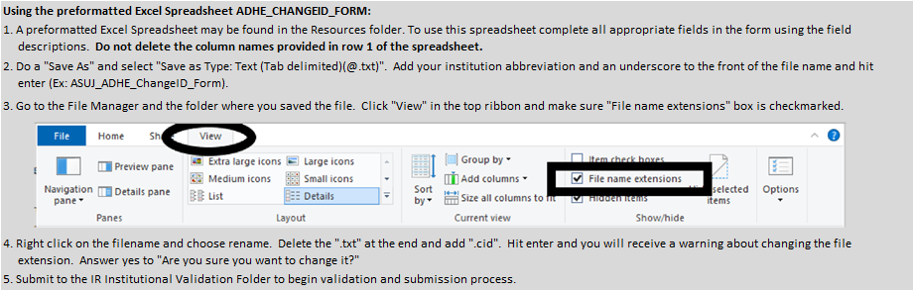
Change ID File
A file extension of .txt on any file besides the Change ID file causes a disruption to the AHEIS system.
The Change ID file extension is being changed to .CID.
Rejection of file drops with an extension of .TXT in the 01-Institutional Validation and 02-Final Submission folders on the FT server will start in the new academic year.
Instructions for changing the file name extension on the Change ID file are included below and in the AHEIS manual.
Notes:
If you do not use the preformatted spreadsheet but instead create your own text file, that is still allowable. Just remember to give the file the appropriate file extension.
A necessary evil because of system blow-ups – have to look for the file – and take it out and restart everything. So this makes it to where your file processing doesn’t get stopped.
Was only file with .txt extension previously.

Slide 5
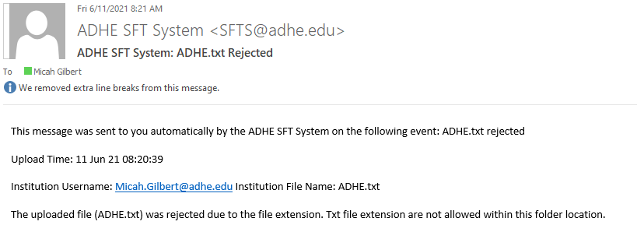
Change ID File
Notes:
A file upload success email will come first, but then you will get this one.

Slide 6
First Generation Students
As part of ADHE’s strategic plan, First Generation status is being added to the student file.
Definition: An individual, neither of whose parents completed a baccalaureate degree; or in the case of any who regularly resided with and received support from only one parent, an individual whose only such parent did not complete a baccalaureate degree.
Data collection will apply to all degree-seeking undergraduates. It will not apply to high school students or graduate/first-professional students.
Optional field for 2021-22 reporting
Required field for 2022-23 reporting
Notes:
Options will be Y, N, U. Definition was recommended by the Goal 3 Equity Workgroup of the strategic plan which had many institutional representatives and agreed to by Dr. Markham.
For those students currently attending, you can choose U if your definition has not matched this one in the past or you do not have the information already – we understand that you may have to use this for a couple of years.
Collection will have to conform to the new definition so that we can properly assess progress with our first generation students. We will be monitoring along the way.

Slide 7
Previously Released File Changes
These file changes were released as separate handouts during the
AHEIS manual meeting in June 2020 to be implemented AY2022.
Perkins II
Workforce Course & Student
Perkins Supplemental Credentials File
New codes added to assessments list
Three new fields have been added to the end of the file layout
Apprenticeship Completed – Y or N
Apprenticeship Code
Other Apprenticeship
File is now submitted on an annual basis.
Due date is September 29 and will cover workforce courses that ended in AY2021 (July 1, 2020 through June 30, 2021)
The list of recordkeeping requirements for workforce courses has been added back into the manual in Appendix J.
Notes:
Please make sure that an assessment or apprenticeship code does not exist before using the other category. If other is used and a code exists, the file will have to be resubmitted once reviewed by Perkins staff.
Requirements have not changed – they were always active – we just didn’t have the requirements listed in the manual anymore.

Slide 8
Test scores for returning/transfer students
The legislature has lifted the reporting requirement of test scores for those students who are receiving state aid and are continuing with your institution, returning to your institution, or a transfer into your institution.
This does not apply to first-time entering, degree-seeking students or concurrent/dual enrolled students. Test scores for those students are still required by state law and AHECB policy.

Slide 9
IDB Calculated Fields
Student Table
  Major Category – STEM, High Demand, BOTH
  Transfer Abbreviation
Course Table
  Term Sort
Instructor Table
  Term Sort
Registration Table
  Term Sort
  Credit Hours
Graduated Student Table
  Degree Category - STEM, High Demand, BOTH
Notes:
In next couple of weeks

Slide 10
REPORTING TIPS
Answers to feedback provided in the AHEIS survey
Notes:
Sonia has addressed some of the responses to the AHEIS survey, but I’m going to address a few more that people had questions about. All of the following slides are in response to questions or comments.

Slide 11
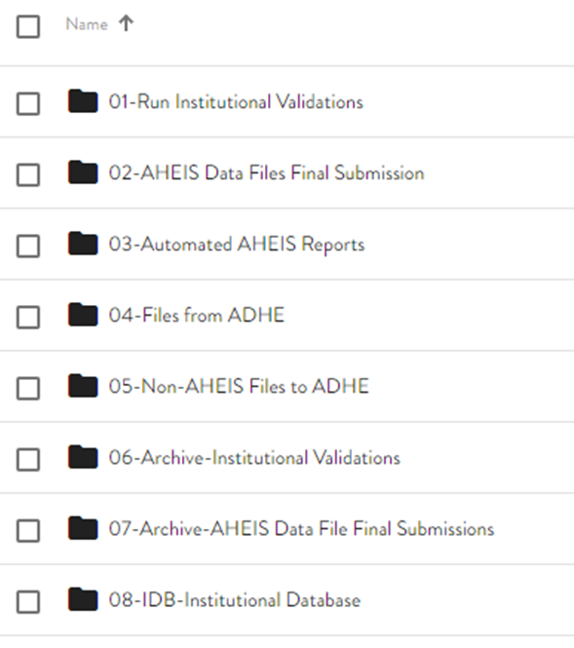
What are the different folders used for on the FT server?

Slide 12
Folder Structure
01 – Run Institutional Validations – Where you drop files for validation
02 – AHEIS Data Files Final Submission – Where you drop files once they have a clean error report
03 – Automated AHEIS Reports – Where error reports and data summaries will appear automatically
04 – Files from ADHE – Where files from ADHE that cannot be emailed for security reasons are dropped for your retrieval
05 – Non-AHEIS Files to ADHE
    Where reports such as the ACTS Transfer or RPTA Report are dropped by you for ADHE’s retrieval
    Where files to ADHE that cannot be emailed for security reasons are dropped for ADHE’s retrieval
06 – Archive-Institutional Validations – Where every file that gets processed through the 01 folder is archived
07 – Archive-AHEIS Data Files Final Submission – Where every file that gets processed through the 02 folder is archived
    The 06 and 07 folders are particularly helpful when you need to retrieve a previously submitted file for some reason.
08 – IDB-Institutional Database – Where a new version of the IDB is placed on a weekly basis
Notes:
Student, Course, Instructor summaries – working on more

Slide 13
What is in the Resources folder?
PDF version of the AHEIS manual
PowerPoint presentation from the AIRO meeting
Reference Files
  ACT High School Codes (appendix E)
  CIP Codes
  Concurrent Placement Test Requirements (appendix F)
  Country Codes (appendix D)
  County Codes (appendix B)
  Exam Type Codes (appendix I)
  FICE Codes (appendix A)
  State Codes (appendix C)
ACT 844
ACTS Course List
Report forms
  ACTS Transfer Report
  ADHE_ChangeID_Form
  Exception Request
  Military Compensation Form
  RPTA Report
Approved Department Codes Excel List
Approved Degree Codes Excel List
Productivity Funding Formula Training Video
The Resources folder is found on the FT server.

Slide 14
File Naming Conventions
Notes:
For term files, the year used is calendar year. For annual files and the GUP, the year used is academic year.

Slide 15
Error Reports
The ID column will always be either the applicable College ID or Sequence Number in question.
The 1st, 2nd, 3rd, and 4th Columns contain additional identifying information to help you find the record in question.
  These values were chosen early in the process and had not been revisited until now. We are going through and making sure that these columns actually point you in the right direction.
ValID is the error code.
  CC = credit course file
  INST = instructor file
  REG = registration file
  STU = student file
Field is the field in question.
Value is the value in the field that is in question.
Reason is the error explanation.
Notes:
Registration has already been fixed. ValID is beneficial because you can filter down to just the student errors, course errors, etc. We use this one a lot in the office.

Slide 16
Data Summaries
It is important to review the data summaries after submissions.
Sometimes data will pass validation because it is "valid" while it is also incorrect.
Sometimes problems can be identified before they lead to serious consequences.
Notes:
Some didn’t even know these were available. We can’t review for all 51 institutions and identify these things. We aren’t nearly as familiar with your institution’s data as you are.

Slide 17
Financial Aid Files
If a code exists for a fund, please use the appropriate code rather than the other category.
We are finding many funds (such as ARFuture) that are being placed in the other category rather than the ‘FUT’ code, for example.
Please review or have your Financial Aid offices review the available codes to make sure that funds are coded correctly.
As AHEIS reporting and dashboarding is gearing up, data inconsistencies such as this will cause questions and confusion.

Slide 18
LIVEBINDER

Slide 19
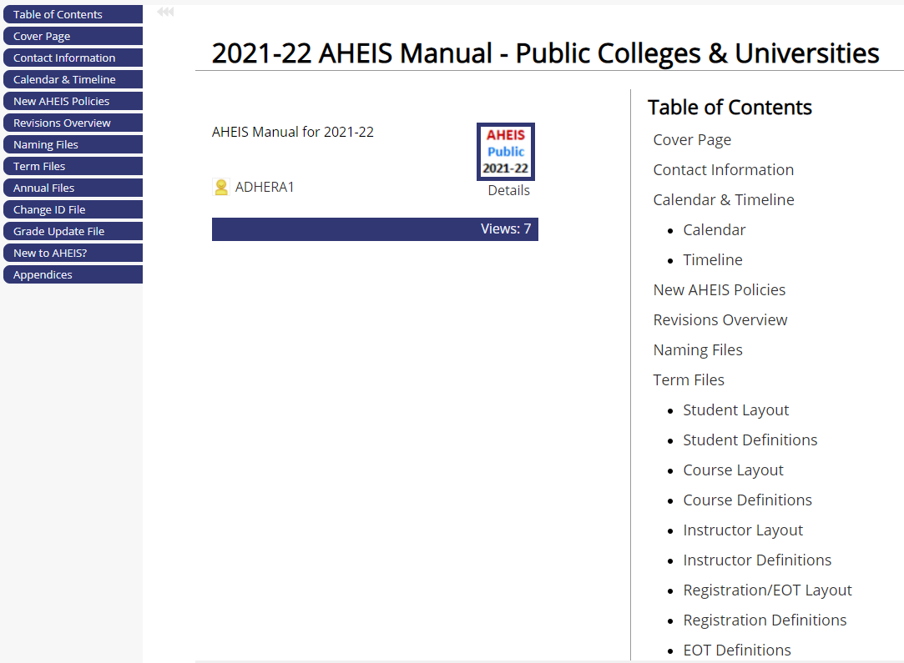

Slide 20
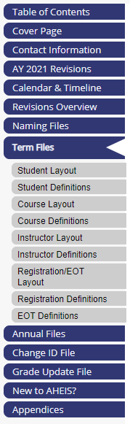
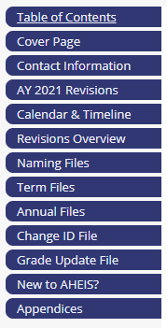
What is LiveBinder?
LiveBinder allows us to share the AHEIS manual on the web while protecting the contents.
You can quickly choose the section you want to see from the accordion on the left side of the page.
Each section can be printed and sent to anyone on your campus – whether as a PDF or print version.
If you are in a meeting where you find you need your manual and don’t have it, the LiveBinder version can be easily retrieved.

Slide 21
What is LiveBinder?
Public manual link: https://www.livebinders.com/b/2814253
  Access Key: Public
Private manual link: https://www.livebinders.com/b/2814257
  Access Key: Private

Slide 22
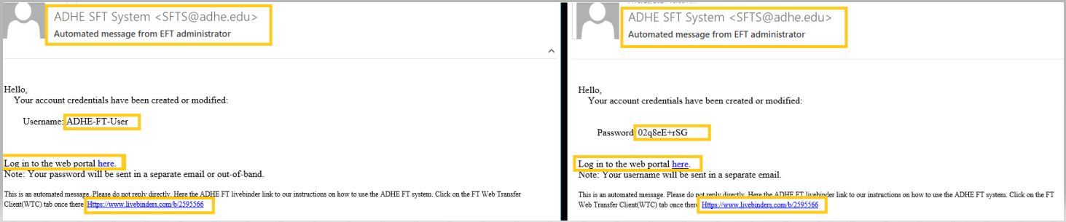
PASSWORD SECURITY
You cannot save your password in your web browser.
https://www.livebinders.com/play/play?id=2595566
Notes:
You change your own password – we don’t change it or control it. It is up to you to share it if multiple people need access.

Slide 23
Institutional Databases (IDBs)
IDBs are a copy of your institution’s data that has been submitted to ADHE going back to 2006.
Each week a new version is uploaded to the 08 folder on the FT server.
Downloading requires use of SQL Server 2016. The PowerPoint instructions that were released last year have been added to the Resources folder on the FT server.
If you have issues or questions, please contact David Jones (david.jones@adhe.edu). Depending on whether you have admin rights to your institution’s SQL server, you may need the assistance of your IT department in this process.
We would encourage you to use your IDB for your IPEDS reporting. This will ensure your IPEDS reports match the data you submitted to the state.

Slide 24
Institutional Databases (IDBs) and College IDs
Three institutions have added the college ID for all of their students in our tables for AY2006 forward.
We would strongly encourage everyone to submit Change ID files adding the college ID for their students and their instructors – especially if using the IDB.
This eliminates the need for using college ID for some years and the SSN for other years when querying the database.
Please contact me to schedule the timing of these large Change ID files. These usually have to be broken into smaller segments.

Slide 25
Questions
If you ever have questions, please do not hesitate to contact me at aheis@adhe.edu.
Chances are that if something is confusing to you, it is confusing to others as well.
This gives us an opportunity to add more clarification in the AHEIS manual.

Slide 26
THANK YOU!
Rachel Lewis
Phone
501-683-7549
Email
AHEIS@adhe.edu
Rachel.j.lewis@adhe.edu

